Slide 1
HALAL Accreditation
ATEEQ UR REHMAN MEMEON
Pakistan National Accreditation Council
Ministry Science & Technology
Pakistan

Slide 2
Sequence
What is Halal and Why Halal
Why Halal Certification
Why Halal Accreditation
Global Halal Market
Real Challenges
How to access International Market
Role of PNAC and International Perspective
Role of Government Authorities
Accreditation Process

Slide 3
Halal Accreditation

Slide 4
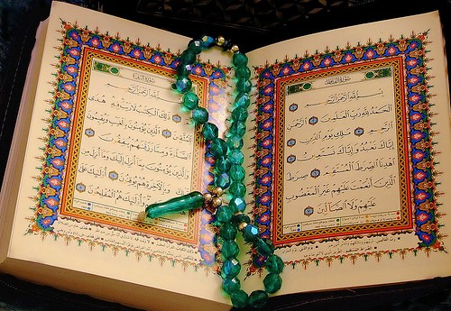
Islamic Rule: It means what ALLAH legislates for Muslims as per the Holy Qur’an, and the practices, (Sunnah) of honourable Prophet Mohammed (peace be upon him).
What is Halal? And Why Halal?
Religiously : allowed by sharia’h ☑ ☺ , permitted ☑ ☺ Sharia’h: Islamic law/Rules, Sunnah & Hadiths of Prophet
Non- Halal: Not allowed by sharia ☒, Not permitted ☒.

Slide 5
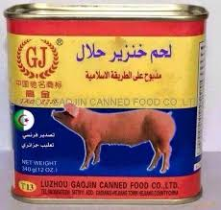
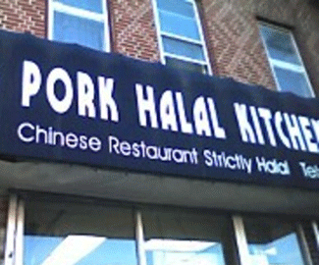
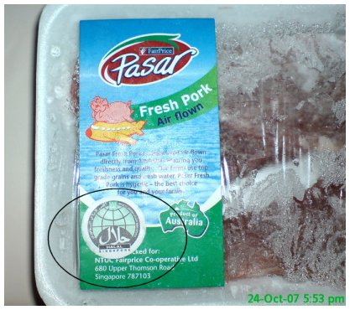
Why Halal Certification

Slide 6
What is HALAL Accreditation?
Halal accreditation is a formal declaration by an accreditation body which testifies that a particular Halal Certifying Body is competent to certify Halalness of specific products or services.

Slide 7
Why Halal Accreditation
IAF, IHAF, SMIIC
Evaluate (MRA/MLA)
Confidence & Trust??
Accreditation
YES
Accreditation Body
(ISO/IEC 17011)
accredit
Halal Certification Body
PS 4992
certify
Halal Certification,
(PS 3733)

Slide 8
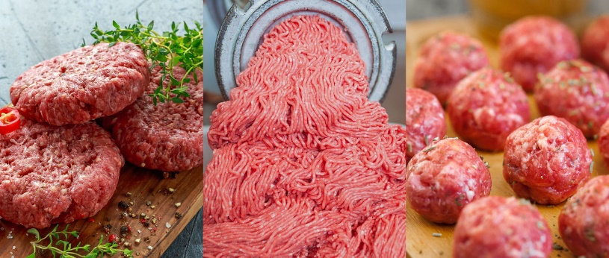
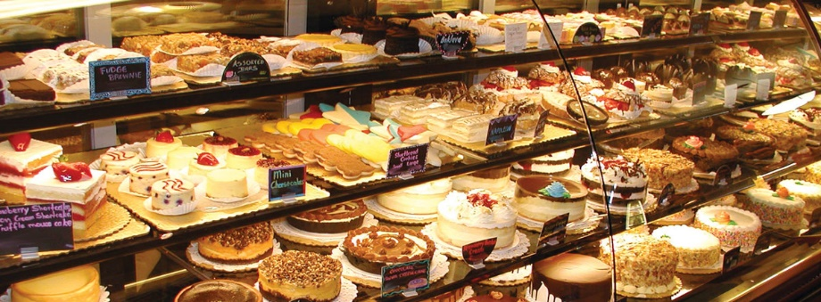
Market Research:
What you think ? How large HALAL market is ?
3.004 Trillion US$ by 2023
The growing awareness of halal food and its positioning as hygienic and healthy food among both Muslim and non-Muslim community is expected to drive the demand over the forecast period.
https://haladinar.io/hdn/doc/report2018.pdf

Slide 9
Global Business Opportunities
Halal FOOD
1.9 tr by 2023 in 2017 was 1.3 tr.
Halal Food alone is 16.6% of the total global
food expenditure. One of the largest food market sector globally.
Over 90 % share of the Halal market holds by non-Muslim countries and remaining by Middle East Countries.
Leaders;
Australia, Brazil, Canada, Indonesia, India, Malaysia Philippines, Thailand, New Zealand, and the USA.
Many Muslim countries Imports; Halal meat, poultry, dairy products, and other foods from;
Europe, Australia, New Zealand, and America.
India (non- Muslim country);
An active player in the halal
food market with US$23 billion export
per annum just by properly organizing the
industry.
Cosmetics
0.09 tr by 2023 in 2017 was 0.061 tr.
Modest Fashion
0.381 tr by 2023 in 2017 was
0.27 tr.
LIFE STYLE
Estimated spending expected to 3.04 tr by 2023
while in 2017 was 2.1 tr.
Pharmaceutical
0.131 tr by 2023 in 2017 was
0.087 tr.
Media & Recreation
0.288 tr by 2023 in 2017 was 0.209 tr.
Travel
0.274 tr by 2023 in 2017 was
0.177 tr.
https://haladinar.io/
hdn/doc/report2018.pdf

Slide 10
DRIVERS FOR THE HALAL INDUSTRY

Slide 11
MARKET MAJOR EXPORTERS

Slide 12
REAL CHALLANGES
Exporters are Non-Muslims and Importer are Muslim
Standardization of Halal Industry
Harmonization of Halal standards for all users
Differences in School of thoughts
Role of International Islamic Forums
Role of Government Institution
Role of Muslim Community

Slide 13
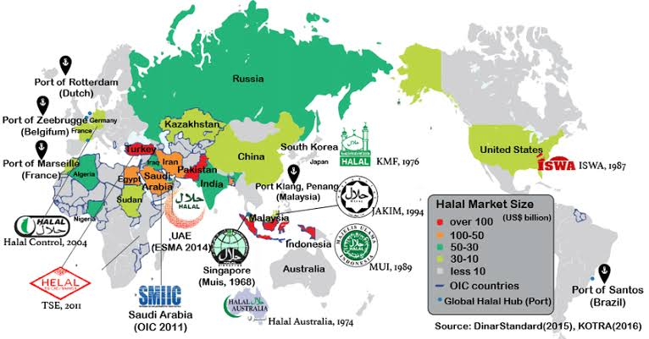
Global Halal Market Potential

Slide 14
Access to Global Market
Tariff Barrier
Fair Competition
Standardization
Safe Products
Tax
Market
Non-Tariff Barrier
Competition
Customs
Tariff

Slide 15
International Requirement
Implementation of WTO agreements
Technical Barrier to Trade (TBT)
Sanitary and Phytosanitary (SPS) Measures

Slide 16
Why PNAC
Sanitary and Phytosanitary (SPS) Measures
It concerns the application of human food safety and animal and plant health regulations.
to protect human or animal life from risks arising from additives, contaminants, toxins or disease-causing organisms in their food;
to protect human life from plant- or animal-carried diseases;
to protect animal or plant life from pests, diseases, or disease-causing organisms;
to prevent or limit other damage to a country from the entry, establishment or spread of pests.

Slide 17
Why PNAC
Technical Barrier to Trade (TBT) Article 6.1.1
Adequate and enduring technical competence of the relevant conformity assessment bodies in the exporting Member, so that confidence in the continued reliability of their conformity assessment results can exist; in this regard, verified compliance, for instance through accreditation, with relevant guides or recommendations issued by international standardizing bodies shall be taken into account as an indication of adequate technical competence;
Technical Barrier to Trade (TBT) Article 9.2
Members shall take such reasonable measures as may be available to them to ensure that international and regional systems for conformity assessment in which relevant bodies within their territories are members or participants comply with the provisions of Articles 5 and 6. In addition, Members shall not take any measures which have the effect of, directly or indirectly, requiring or encouraging such systems to act in a manner inconsistent with any of the provisions of Articles 5 and 6.

Slide 18
Who We Are
PNAC Established 1998 (Cabinet Decision)
PNAC Act April 2017
Functioning under administrative control of Ministry of S & T
International Acceptability/Mutual Recognition Arrangement (MRA)
Reduction of Non Tariff barriers

Slide 19
National Quality Infrastructure
Metrology
NPSL
Testing
Certification
National
Quality
Infrastructure
PCSIR
Private
Private
Standardization
Accreditation
PNAC
PSQCA

Slide 20
International Recognition of PNAC
ILAC: International Laboratory Accreditation Co-operation:
http://www.ilac.org
IAF: International Accreditation Forum http://www.iaf.nu/
EA: European Coopertion for Accreditation http://www.european-accreditation.org/
APAC: Asian Pacific Accreditation Cooperation http://www.apac-accreditation.org

Slide 21
International Recognition of PNAC
IHAF– International Halal Accreditation Forum
http://ihaf.org.ae/
SMIIC– The Standards and Metrology Institute for the Islamic Countries https://www.smiic.org/en/smiic

Slide 22
International Recognition PNAC
Mutual Recognition Arrangements (MRA):
Calibration laboratories
Test laboratories
Inspection bodies
Multilateral Recognition Arrangements (MLA):
Certification bodies
Products
Quality management systems
Environment management systems

Slide 23
Benefits of PNAC International Recognition
demonstration of conformity
marketing tool
overcome technical barrier to trade
reduce product liability
increase confidence
Producer
Regulator
reliable testing, certification and inspection results
reduce cost of market surveillance
de-regulation tool
increase transparency
Consumer
reduce risk of non-conforming product
source of reliable service
mark of quality
more variety of products

Slide 24
What we do
Accreditation Schemes:
Laboratories (ISO/IEC 17025)
Certification Bodies (ISO/IEC 17021)
Inspection Bodies (ISO/IEC 17020)
Medical Laboratories (ISO 15189)
Halal Certification Bodies (PS 4992)
Proficiency Testing (ISO/IEC 17043)
Product Certification (ISO/IEC 17065)
Personnel Certification (ISO/IEC 17024)

Slide 25
What has been done so far
CABs Accredited
Testing & Laboratories 170
Certification Bodies (CB) 07
Inspection Bodies (IB) 11
Medical Labs 10
Halal CBs 07
Proficiency Testing Providers 04
Product Certification 01
Personnel Certification 01

Slide 26
Federal Government Authority
Ministry of Commerce
Issued SRO related to import halal product with traceable halal logo
Pakistan Halal Authority (PHA)
Import and export of Halal Products.

Slide 27
Provincial Government Authorities
KPK Food and Halal Development Authority
Punjab Halal Development Agency
Sindh Food Authority
Baluchistan Food Authority

Slide 28
Role of Standard Development Council (PSQCA)
1 | PS: 3733-2016 | Pakistan Standard for Halaal Food Management System Requirements for any organization in the Food chain
2 | PS: 5319: 2014 | Pakistan Standard for General Guidelines for Halaal Cosmetics and Personal Care Products
3 | PS:4992-2016 | Pakistan Standard for conformity assessment – Requirements for bodies providing Halaal Certification Services
4 | PS: 5241-2013 | Pakistan Standard General Requirements for the Accreditation Body Accrediting Halaal Certification Bodies
5 | PS: 247-2013 | Pakistan Standard Edible Halaal Gelatin
6 | PS: 5401-2017 | Pakistan Standard – Principles for food import and export inspection and certification
7 | PS:5400-2017 | Pakistan Standard- Guidelines for the exchange of information between countries on rejection of imported food

Slide 29
Requirements for Halal Accreditation and certification
PS: 4992 (For Certification Bodies)
PNAC’s specific requirements for HCBs Part I, II & III
PS: 3733 (for Organization / Traders / Manufacturers)
SMIIC– The Standards and Metrology Institute for the Islamic Countries
OIC guidelines

Slide 30
PNAC Awareness Project on
Halal Accreditation
With the objectives
To spread awareness across country;
What is Halal Accreditation and its importance?
Why we need Halal Accreditation in our country?
Benefits to stakeholders.
To provide training on Halal Accreditation standards and international practices.
To train a pool of accessors / expert.
To encourage certification bodies toward Halal Accreditation as HCB.

Slide 31
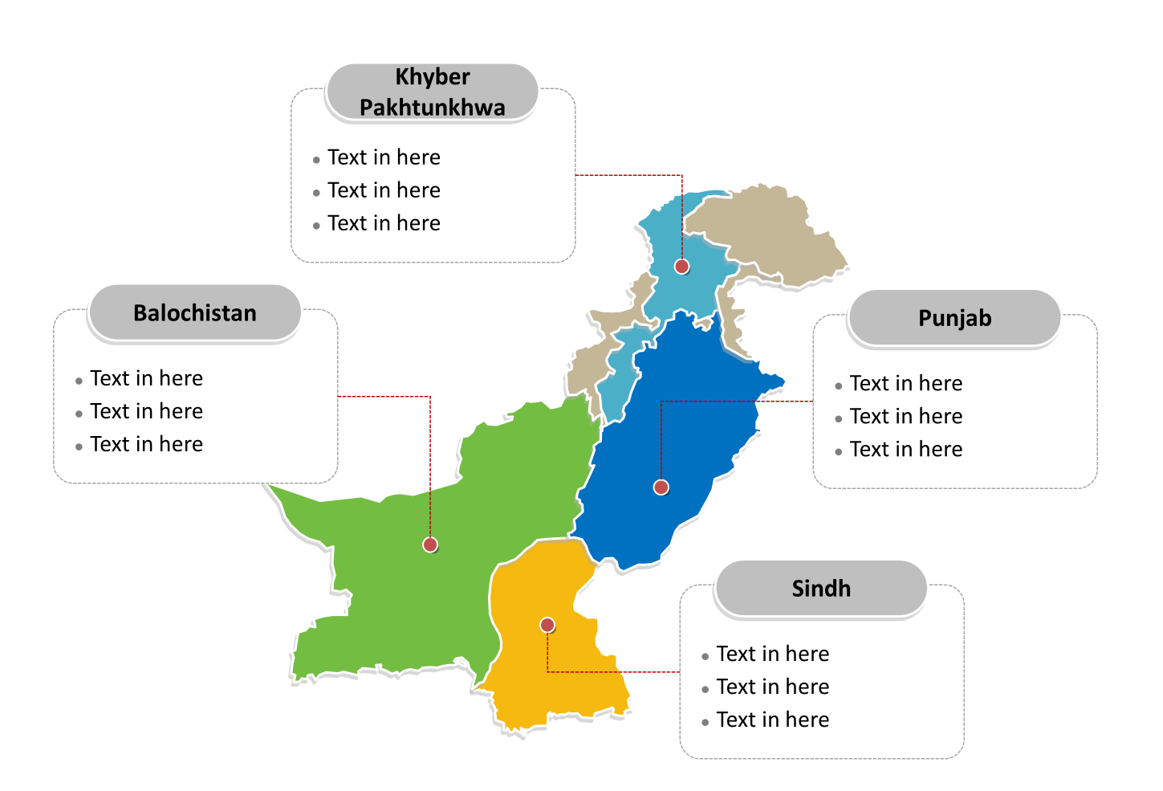
Awareness raising programs
Administrative Province
KPK
Skardu
AJK Mirpur
Swat
Haripur
Peshawar
Mardan
BALOCHISTAN
PUNJAB
Islamabad
Lahore
Faisalabad
Lahore
Multan,
Quetta
SINDH
Covered
Target
A= Awareness Seminar
T= Training on Standards
Karachi
Sukkhar
Hyderabad

Slide 32
Halal Accreditation Mark
HALAL CB 000
PS: 4992

Slide 33
Accreditation Process
Enquiry
Decision by DG &
award of accreditation
Application
Surveillance
After one year
Pre-assessment
Surveillance
After one year
Assessment
Re-assessment
After three year
Corrective Actions
Review

